Slide 1
Diversity and Inclusion Efforts in the Julia Community
Logan Kilpatrick
Julia Language Community Manager

Slide 2
Agenda:
What we have done in the last year
Background info on Google Analytics
JuliaLang Website
Discourse
The Docs
Julia Academy
YouTube
Takeaways & Next Steps

Slide 3
What we have done:
Launched 3 new Julia Academy courses
Supported 212 Students in GCI
Currently mentoring 25 students through JSoC/GSoC
Participating in our inaugural year of GSoD/JSoD
Partnered w/ MLH for the inaugural year of the MLH Fellowship
Made Julia events global
Notes:
15,000 people signed up for JuliaAcademy in the last year.

Slide 4
Important Notes:
Most of these stats come from Google Analytics. You can read more about Google Analytics here: About Demographics and Interests - Analytics Help
While Google does have a lot of data, it is not calculating all of the metrics about our users 100% correctly. Google does not provide a standard margin of error so please take all of these numbers with a healthy dose of skepticism.
(Jul 28, 2019 - Jul 28, 2020 ) vs (Jul 26, 2018 - Jul 27, 2019)
Notes:
Google Analytics also does not provide data on people’s ethnicity so I will only be presenting data on Gender and Age.

Slide 5
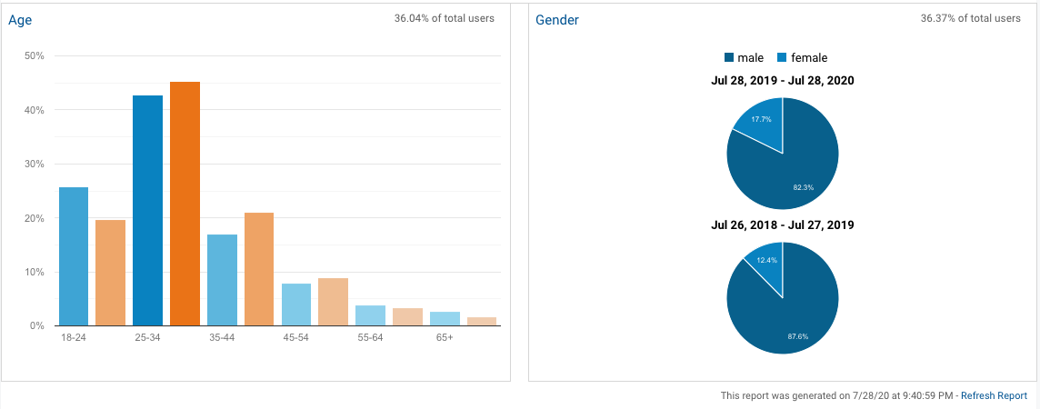
JuliaLang.org
How Google defines a user: https://support.google.com/analytics/answer/2992042?hl=en&authuser=2

Slide 6
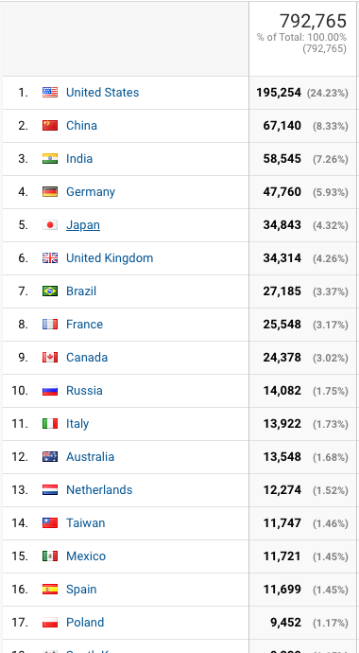
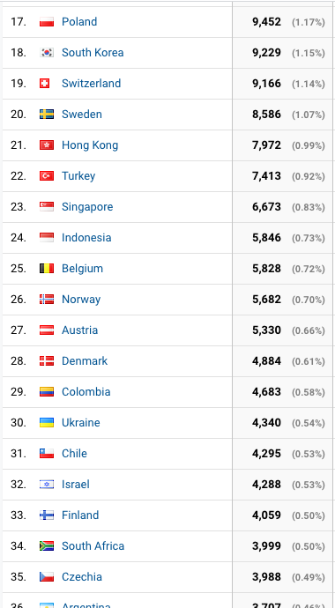
JuliaLang.org
How Google defines a user: https://support.google.com/analytics/answer/2992042?hl=en&authuser=2
Notes:
People visited the Julia website from 224 different countries

Slide 7
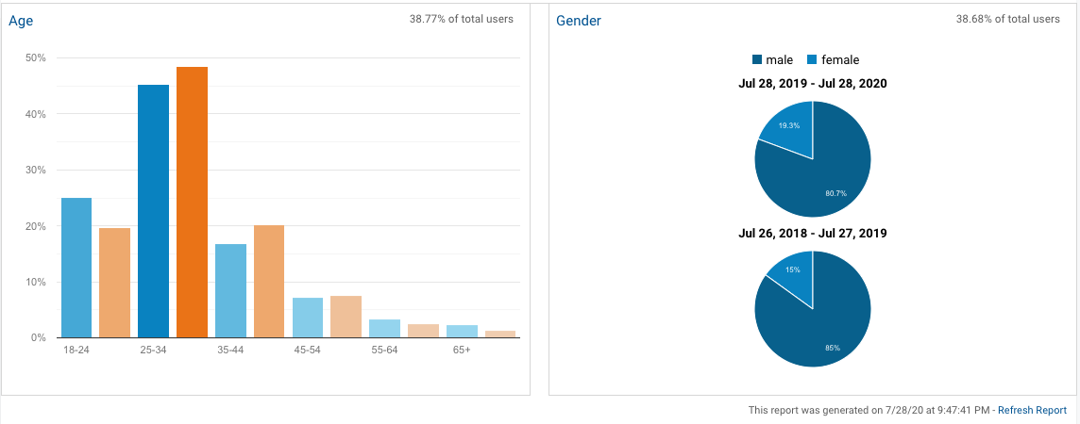
Discourse.JuliaLang.org

Slide 8
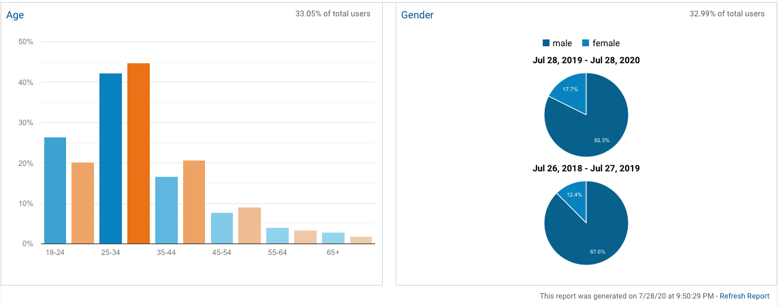
Docs.JuliaLang.org

Slide 9
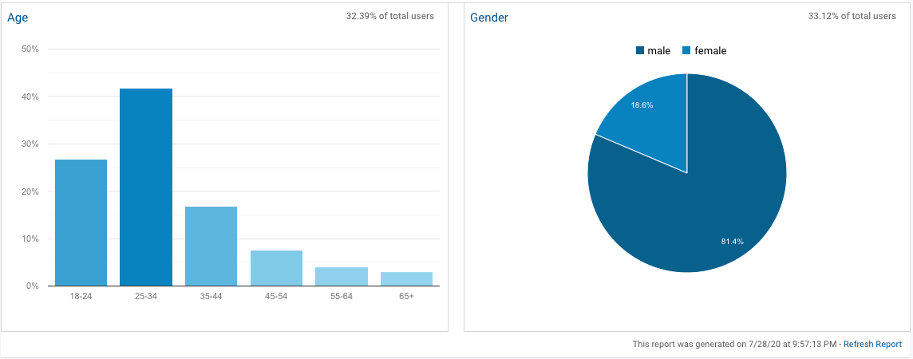
JuliaAcademy.com
Notes:
JuliaAcademy launched September of 2019 so we don’t have accurate numbers to compare against.

Slide 10
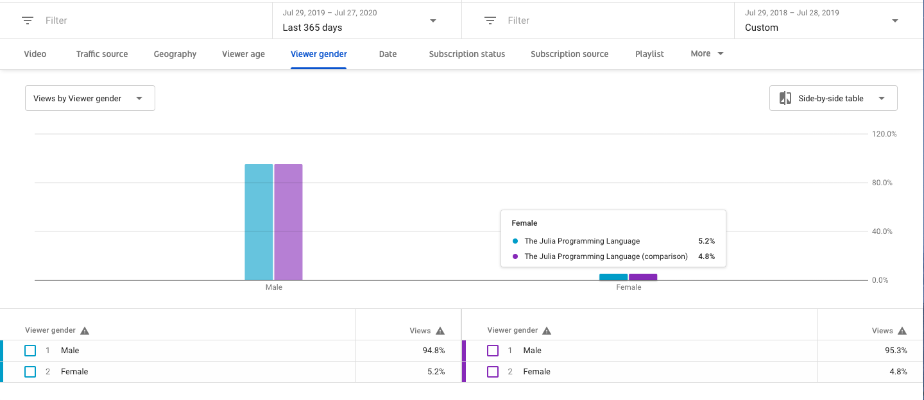
The Julia Languages YouTube
Notes:
This data is not from Google Analytics and is instead taken directly from YouTube’s built in analytics page. Mention YouTube tags, mention diversity increased during JuliaCon’s...

Slide 11
Takeaways:
The Julia Community is becoming more diverse.
We still have a lot of work to do and room to improve.
Next Steps:
Come to the “Moving forward on diversity & inclusion in the Julia community” BoF today 16:55 –17:40 on Discord!
Send any suggestions or the like to diversity@julialang.org or join the #diversity channel on Slack.
Notes:
Huda and August will be leading the Diversity and Inclusion BoF.

Slide 12
Thank you!
Questions? Ping me on Discord in the Red Track chat, on Slack, or via email at logan@julialang.org

Slide 13
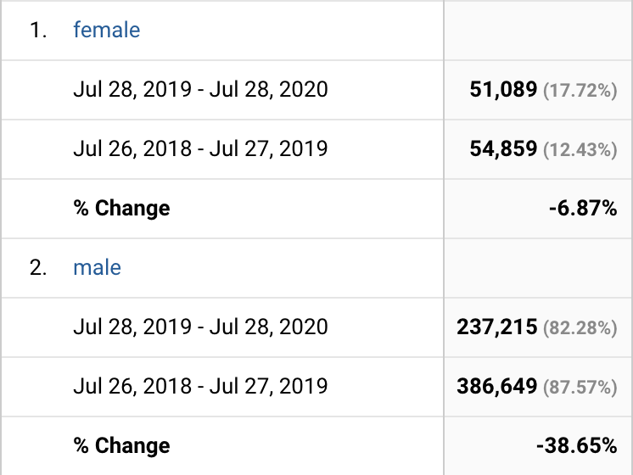
JuliaLang.org
How Google defines a user: https://support.google.com/analytics/answer/2992042?hl=en&authuser=2

